Slide 1
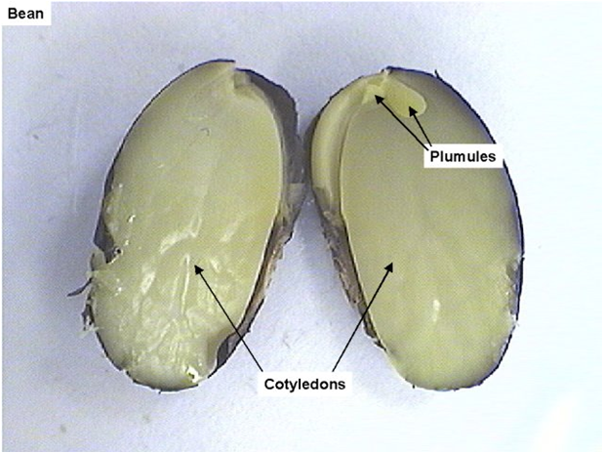
PLANT REPRODUCTION AND AGRICULTURE

